Slide 1







WORKFORCE MANAGEMENT INSIGHTS
Data-Driven Employee, Payroll, and Performance Insights Using SQL
- Aishwarya

Slide 2

INTRODUCTION
This presentation gives an overview of the Employee Management System SQL project.
This project is designed to make handling employee data easier and more organized.
Key queries are shown with simple explanations to make data management easy to understand.
The focus is on insights into employee data, payroll, salary, bonus, department analysis, roles, and leave management.

Slide 3

OBJECTIVE
To design and implement a system that efficiently stores and manages employee-related data.
To track employee information including personal details, job roles, salary, qualifications, leaves, and payroll..
To ensure integrity and consistency of data using relational tables and foreign keys.
To simplify HR operations by making employee data easily accessible and accurate.

Slide 4
ABOUT THE TABLES
The project uses multiple interconnected tables to manage and analyze workforce data efficiently.
Key Tables:
Employee – Stores personal details like Employee ID, Name, Age, Gender, and Department.
Job Role & Department – Contains Department ID, Department Name, and Manager information. Lists Job Role ID, Job Title, Department ID, and Salary Range.
Qualification & Skills – Tracks educational and professional qualifications for each employee. Contains employee skills and proficiency levels.
Leave – Records leave types, start and end dates, leave duration, and employee ID.
Payroll – Contains salary, bonus, deductions, and total payroll processed for each employee.
Promotion – Tracks employee promotions over the years.

Slide 5


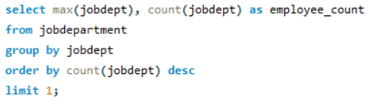

ANALYSIS QUESTIONS 1. Employee Insights
How many unique employees are currently in the system?
Which departments have the highest number of employees?

Slide 6
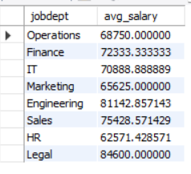
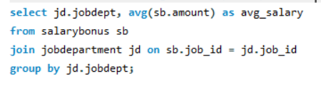
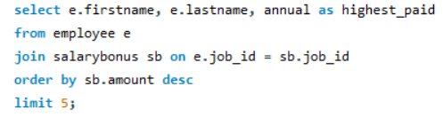
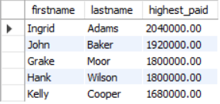


What is the average salary per department?
Who are the top 5 highest-paid employees?
What is the total salary expenditure across the company?

Slide 7
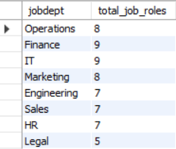

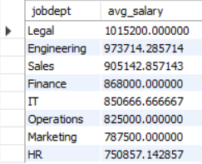
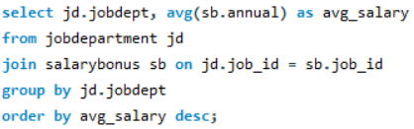
2. Job Role & Department Analysis
How many different job roles exist in each department?
What is the average salary range per department?

Slide 8
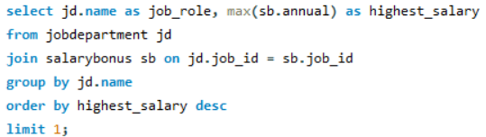

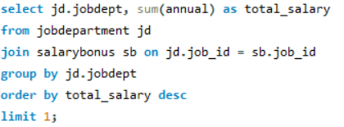

Which job roles offer the highest salary?
Which departments have the highest total salary allocation?

Slide 9




3. Qualification & Skills Analysis
How many employees have at least one qualification listed?
Which positions require the most qualifications?

Slide 10


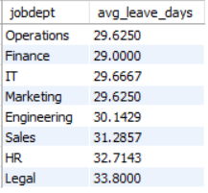
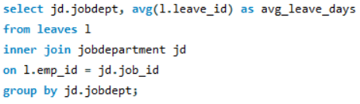


4. Leaves & Absence Patterns
Which year had the most employees taking leaves?
What is the average number of leave days taken by its employees per department?
What is the total number of leave days taken company-wide?

Slide 11
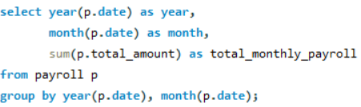

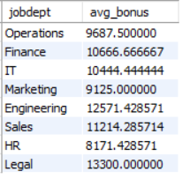
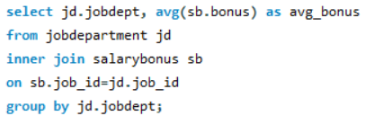
5. Payroll & Compensation
What is the total monthly payroll processed?
What is the average bonus given per department?

Slide 12
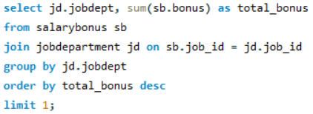



Which department receives the highest total bonuses?
What is the average value of total_amount after considering leave deductions?

Slide 13
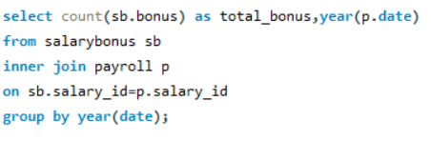

6. Employee Performance & Growth
Which year had the highest number of employee promotions?

Slide 14
FINAL BUSINESS INSIGHTS & RECOMMENDATIONS
Insights
IT & Finance departments have the highest salaries and workforce.
Directors & Senior Managers account for the largest payroll expenses.
Most employees have at least one qualification; some roles require more.
Leave requests peak during festivals and vacation months.
Payroll and promotions are closely tied to bonuses and performance.
Recommendations
Balance workforce across departments.
Benchmark salaries and bonuses with industry standards.
Encourage employee upskilling programs.
Plan leave schedules around peak periods.
Automate payroll for better accuracy and efficiency.
Link promotions and bonuses to measurable KPIs.

Slide 15
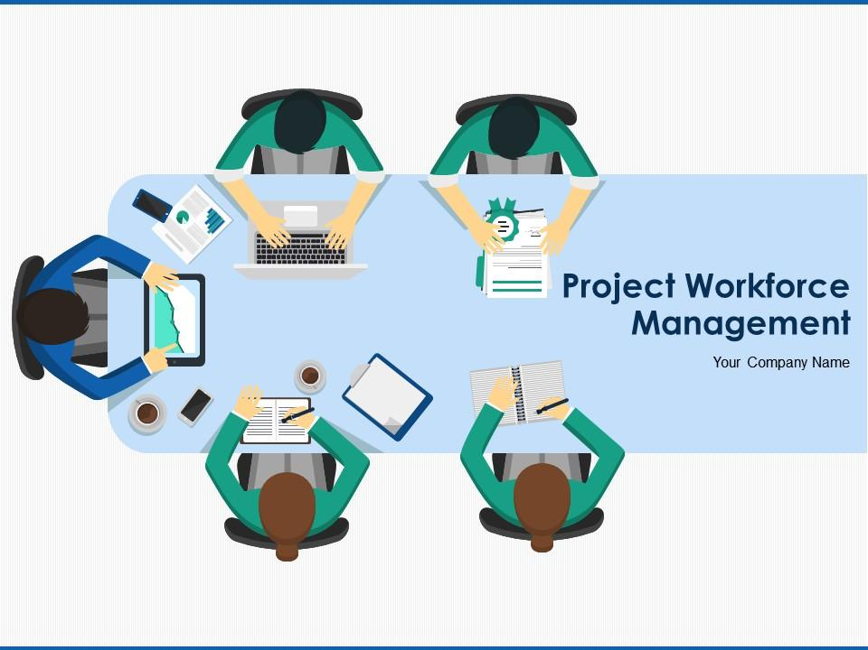
CONCLUSION
This SQL project successfully designs an Employee and Payroll Management System that manages employee records, job roles, salaries, bonuses, qualifications, leaves, and payroll reports.
By executing SQL queries, the system generates actionable insights that enable data-driven HR decisions and provide a strong foundation for organizational strategies aimed at optimizing workforce management and improving productivity.

